Slide 1
What do we know about effective preschool programs?
Steve Barnett, PhD

Slide 2
Potential Gains from Pre-K Investments
Educational , Social and Economic Success
Achievement test scores
Special education and grade repetition
High school graduation
Behavior problems, delinquency, and crime
Employment, earnings, and welfare dependency
Smoking, drug use, and even health
Decreased Costs to Government
Schooling costs
Social services costs
Crime costs
Health care costs (teen pregnancy and smoking)

Slide 3
What does all the evidence say? Cognitive gains from ECE in the US (123 studies since 1960)

Slide 4
What do we learn from reviewing all the evidence?
Achievement and opportunity gaps begin well before kindergarten-- for low-income, minority, & middle-income
Preschool has positive effects that appear to diminish (converge) after children enter school but do not disappear
Preschool can meaningfully reduce achievement gaps for low- and middle-income families
Only high quality, intensive programs have meaningful effects
Include self-regulation, socialization, & academics to influence life success
Effective preschool can be scaled up
Most private and public programs are not high quality and sufficiently intensive
Head Start and some state pre-K had weak lasting effects, though Head Start has been improved
HQ, intensive preschool is a high return investment, but the costs are upfront while benefits stretch over a lifetime--with start up funds states can pay out of cost savings in the long-term

Slide 5
Pre-K quality is too low across the country but is much higher in one region

Slide 6
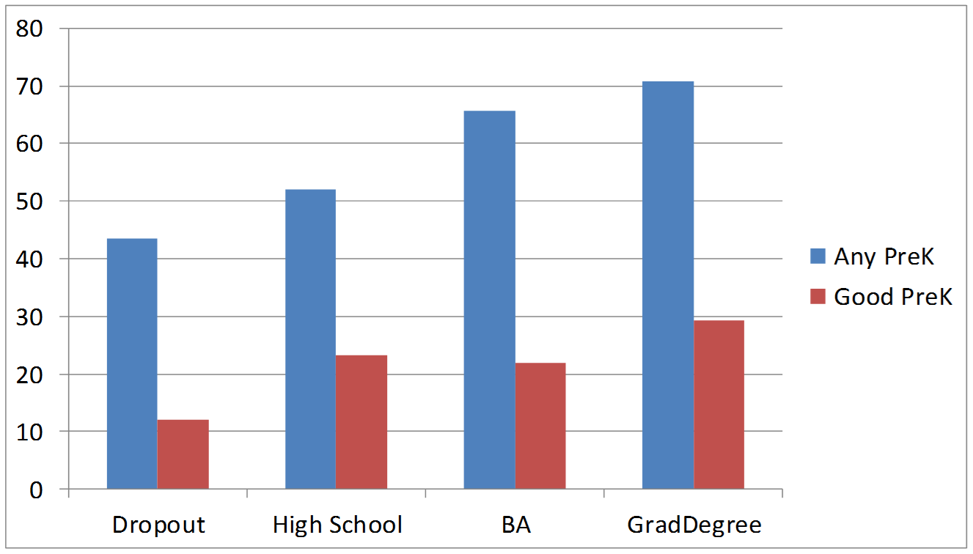
Good Preschool is least available to families with the least education, but no one has much

Slide 7
What are the features of programs producing large lasting impacts?
High standards for learning and teaching
Well-educated teachers, adequately paid
Reasonably small classes and ratios
Strong curriculum well-implemented with a focus on intentional teaching 1:1 and in small groups
Attention to the whole child and family engagement
A continuous improvement system that focuses on teaching and learning

Slide 8
Reasons to Improve Public Preschool
Relatively few children have access and growth has stalled
Just ½ of 4’s in poverty get any preschool
What children receive varies greatly
Access is highly unequal across and within states
Hours and days offered are highly uneven
Quality standards vary greatly across states
Funding per child varies greatly across states
Effectiveness ranges from a little to a lot
Examples of large scale success can be replicated
OK, NJ, NC, MI, Boston, Montgomery Co. MD

Slide 9
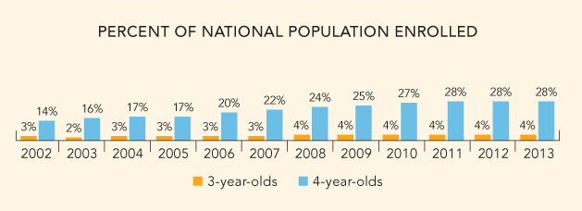
National Enrollment in State Pre-K
9,000 fewer 4-year-olds served in 2012-2013
11 states enrollment declined
20 states increased enrollment
Notes:
Enrollment stagnated. More than 9,000 fewer children were enrolled than the previous year; fact that percentages stayed same indicates this just kept up with slowed population growth.

Slide 10
State provision varies tremendously
Notes:
What kids get depend on where they live - this is true of funding and quality as well, but there are jarring differences in access.
10 states had no state-funded pre-K in 2012 - 2013, largely in the Mountain West. Mississippi was one southern hold out, but started a small program in 2014. Hawaii is also beginning a state-funded program, and Indiana is moving on a small pilot program. Future yearbooks will be updated as these programs develop.
Even in states with high access, there are huge differences. Rhode Island and Alaska started programs in recent years and only serve 1 and 2 percent, respectively. Oklahoma serves over 74%, which it has built to over a long period; Floridas serve 79% and grew quickly since constitutional amendment requiring pre-K as of the 2005-2006 year.
There is no ONE way that states have built access.

Slide 11
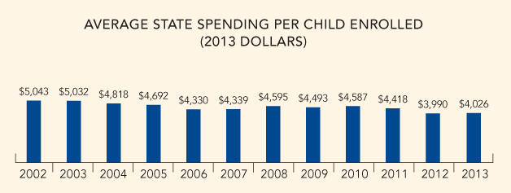
Pre-K Funding
Total state pre-K funding increased by $30M (adjusted for inflation) in 2013
Funding per child remains $1,000 below level a decade ago
In 5 states per-child spending fell by 10% or more; 5 states increase
Notes:
$5.3B total
Total state funding for pre-K programs increased by $30M after PY when it decreased by more than $548 million across the 40 states that offer pre-K.
State funding per child for pre-K increased by at least 1% in 17 of 41 states with programs, when adjusted for inflation
Fell by same in 21 states.
In 5 states per-child spending fell by 10 percent or more from the previous year while the same number of states increased by 10% or more.

Slide 12
How to help states?
Incentives to raise quality standards and implement continuous improvement processes
Incentives to create & expand state pre-k
Matching funds for low-income children in state pre-K to increase quality & intensity
Fund preparation and PD of preschool staff to become highly qualified
Use preschool as leading edge of education reform
Coordinate Head Start & child care policies to raise quality and integrate with state preschool
No second class standards for poor children

